Slide 1
Defi options trading
S-K
XIAO Li, Harsh Lakhani, DONG Wenyu

Slide 2

Contents
General Information
Demo
Future Enhancement Direction

Slide 3
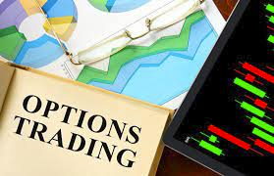
Background
DeFi options are low-barrier borderless instruments that can be easily traded among peers on the platform without involving brokers or paying brokerage.
Pros
Reduce risk
High premiums for sellers
Cheaper portfolio diversification
Create users own customized options and vaults
Cons
More sophisticated options are scarce
High volatility — Price forecasting is difficult
Leveraged transactions — magnify traders’ potential gains or losses

Slide 4
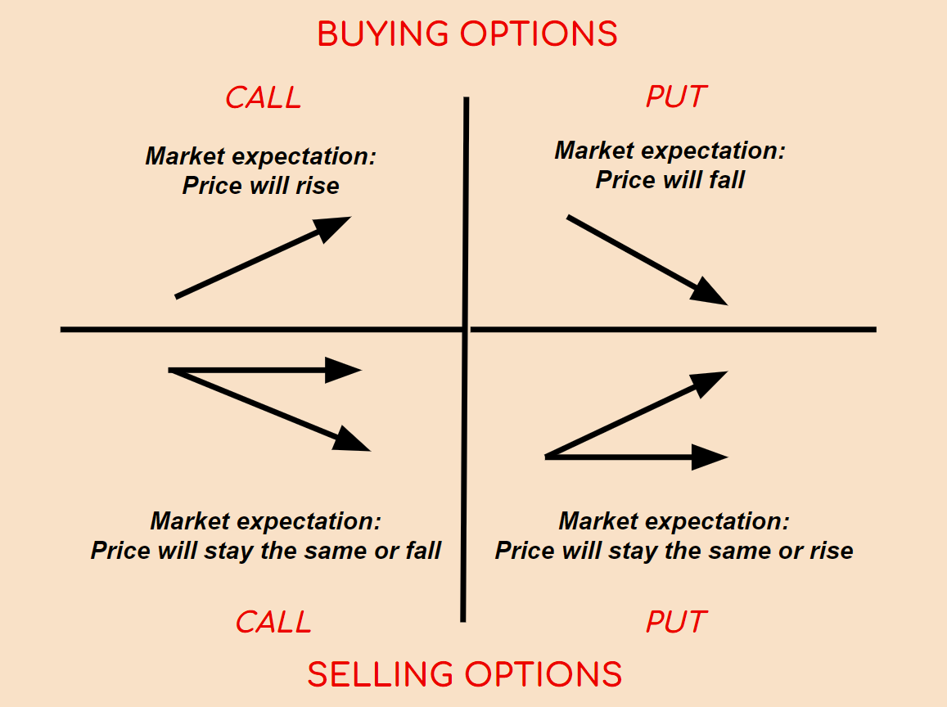
Types
Call options allow the owner to buy a specified amount of underlying asset at a fixed price within a specific period of time.
Put options allow the holder to sell a specified amount of underlying asset at the strike price within a specific timeframe.

Slide 5
Target Market
The defi options market is vast, with an increasing trend in terms of quantity and quality of target users.
Hedger, hedge against potential risk in crypto market (high volatility)
provide 7-day put option for crypto buyer
Each option is backed by the notional value held by the user, which eliminates counterparty risk and ensures that the option holder can always purchase or sell the underlying token in a pre-fixed price.
Companies or funds with event risk hedging needs, such as high exposure with crypto.
Speculators, try to make a profit from a security's price change
Directional speculators, who take small chances with options, and who .
Volatility speculators.
Discord

Slide 6
Solution
An on-chain peer to peer option trading protocol
Create crypto
stablecoin (cMMD,usd)
2. unstablecoin (MMD,stock)
Create option contract
Seller write option
Buy option
Exercise option
Seller cancel option
Retrieve funds

Slide 7
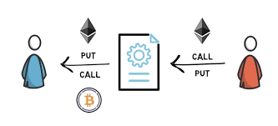
Innovation
User interface is easy to operate, which is friendly to new trader
Continuously expanding functions
MMD acts as underlying assets, cMMD acts as currency
Move traditional derivatives trading to the blockchain
No middleman involved, overall lower fees than traditional trading systems
Reduced counterparty risk, since the rule is protected by smart contracts
Automated system because of the use of smart contracts (condition-based)

Slide 8
Demo
https://github.com/Joe-Bradley/S_K

Slide 9
Future Enhancement Direction

Slide 10
cMMD should be pegged to the USD
Exchange rate between cMMD and MMD should be floating
Implement a liquidity pool to allow buyers to decide the parameters of option they want to buy
Implement pricing function of option under 3
Logic for front-end interactions must be optimized, and quick feedback on errors must be provided.
Support different MMDs with uniswap

Slide 11
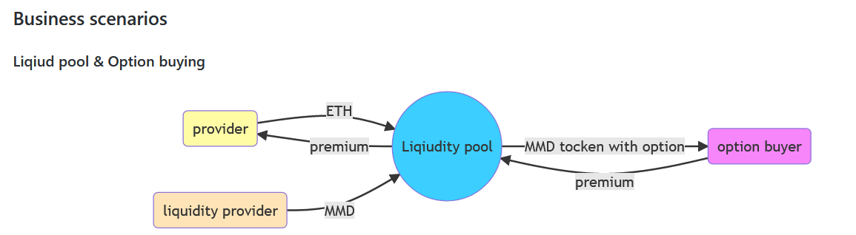
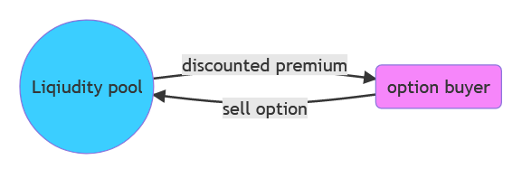
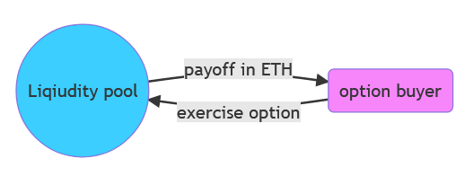
Sell Option
Exercise Option

Slide 12
Thanks
Q & A

